Slide 1
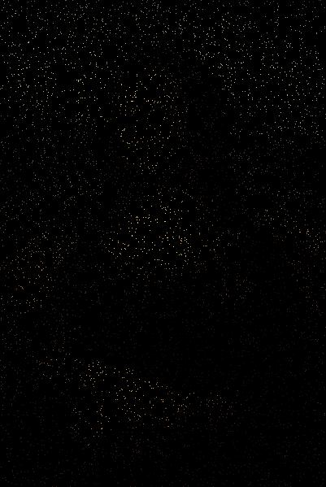

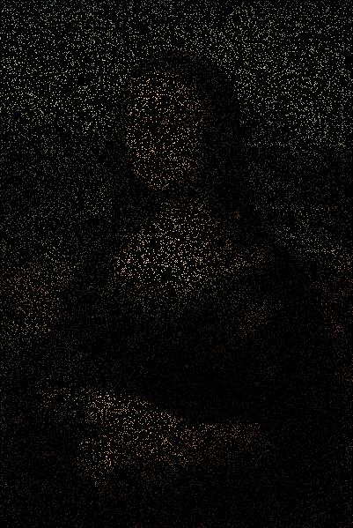
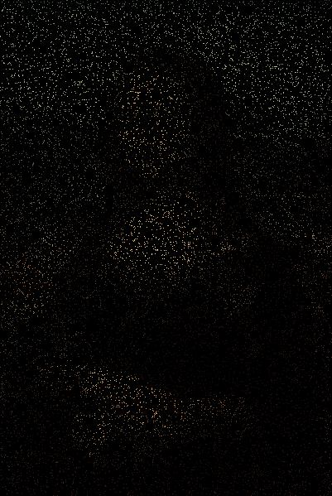
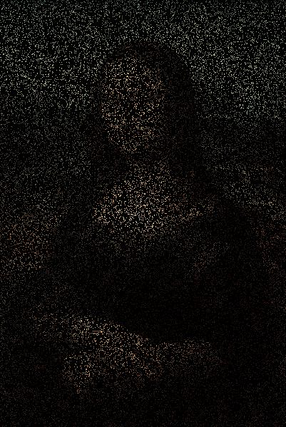
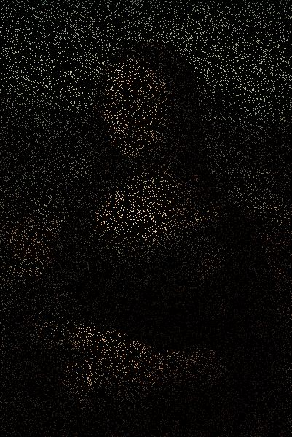
Pixels are very small dots of colour. If you set the size of your canvas with size(W, H) then it will contain W * H pixels. Each pixel is made up of an amount of red, green and blue. The amounts for each RGB colour are in the range [0, 255] so we can make 256 * 256 * 256 composite colours. That’s 16777216 different colours!
Cols
0
1
2
3
4
5
0
Rows
1
2
3
The screen
MonaLisa0

Slide 3
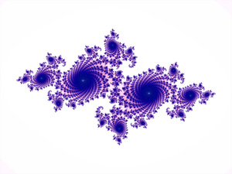
PImage Pic;
void setup() {
Pic = loadImage("Small Mona Lisa.jpg");
size(Pic.width, Pic.height);
background(0);
frameRate(1000);
}
void draw() {
int i;
int x,
y;
x = int(random(Pic.width));
y = int(random(Pic.height));
color pixcol = Pic.get(x, y);
set(x, y, pixcol);
}
An image is loaded but not displayed at once because we have not used the image() method.
We use the images width and height to set the size of the canvas.
Sets background to black
Set frame rate high – there are a lot of pixels to colour in! In practice it managed 650ish frames per second on my computer.
get(x, y) returns the RGB colour of the screen pixel at (x, y).
Note that we do not use image() to display the picture. We usually access the variable Pic, which is an object containing pixel data etc. for the actual image to be drawn by image(). As shown here we can use that data in other ways.
set(x, y, pixcol) sets the RGB colour of the screen pixel at (x, y).
MonaLisa0

Slide 4
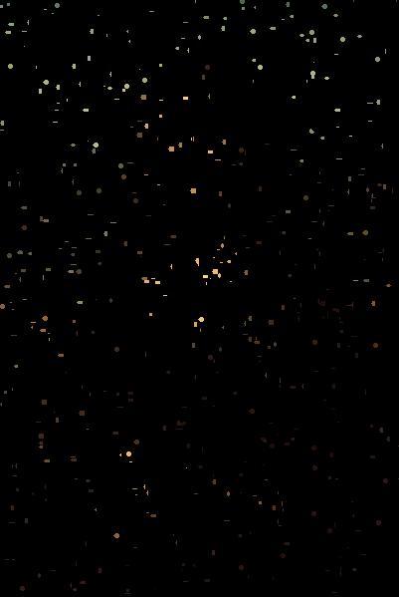
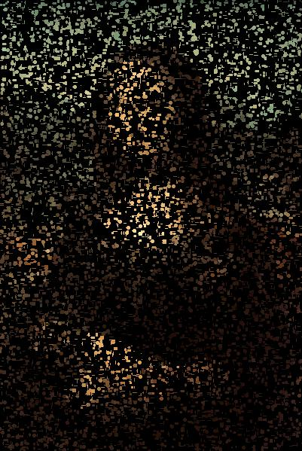
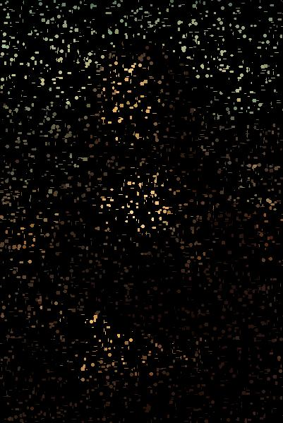
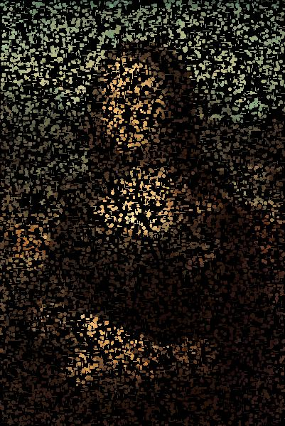
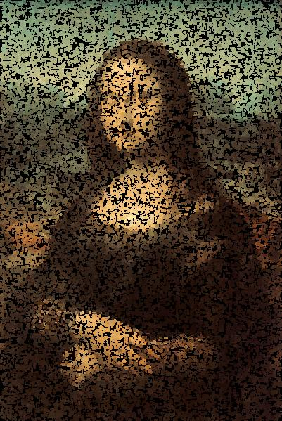
MonaLisa0

Slide 5
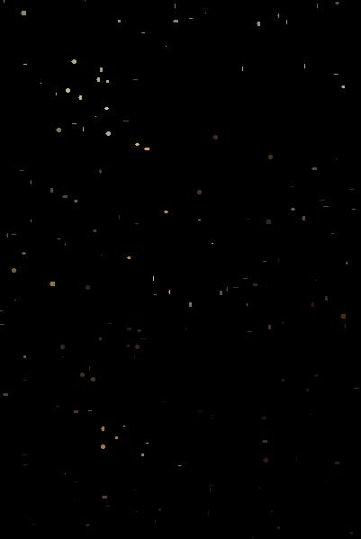
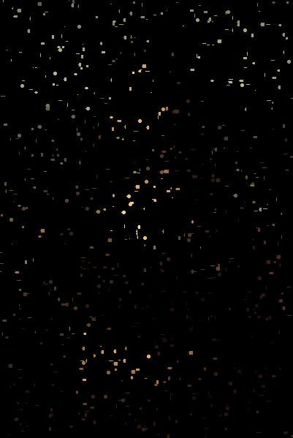
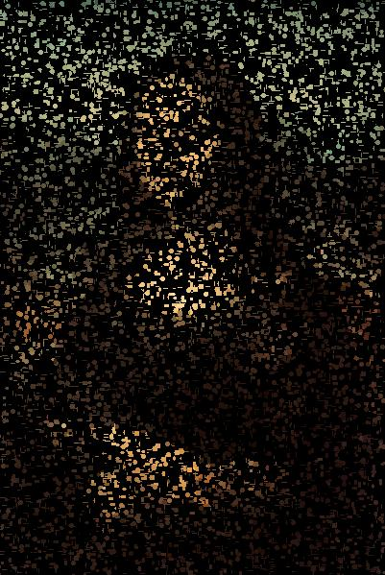
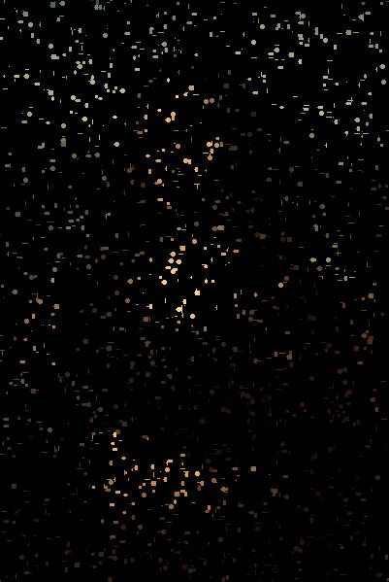
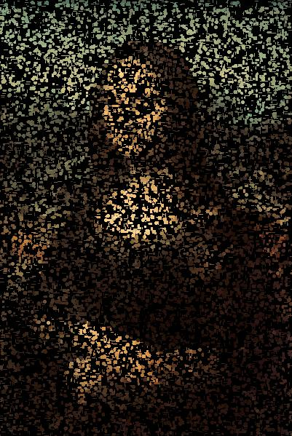
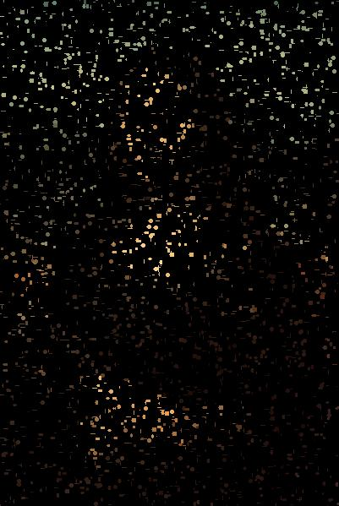
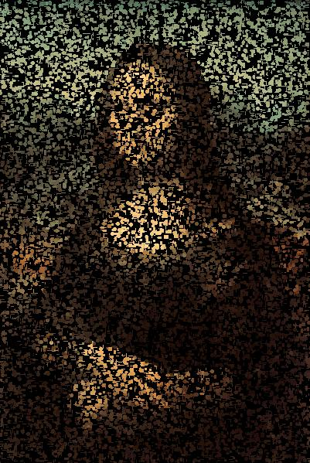
PImage Pic;
float PointSize = 3;
int Top = 1;
void setup() {
Pic = loadImage("Small Mona Lisa.jpg");
size(Pic.width, Pic.height);
noStroke();
background(0);
frameRate(1000);
}
void draw() {
int x,
y;
x = int(random(Pic.width));
y = int(random(Pic.height));
color pix = Pic.get(x, y);
fill(pix);
ellipse(x + int(random(5)) - 2, y + int(random(5)) - 2,
int(random(2 * PointSize)) + 1, int(random(2 * PointSize)) + 1);
}
MonaLisa1

Slide 6
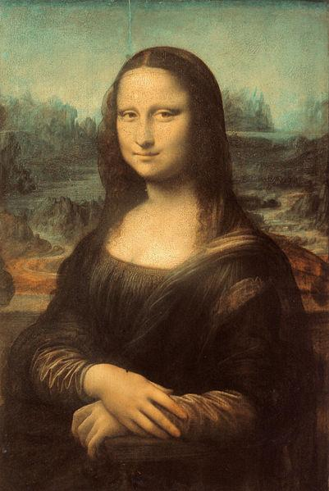
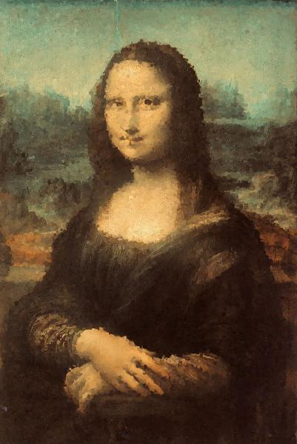



PImage Pic;
float PointSize = 3;
int Top = 1;
void setup() {
Pic = loadImage("Small Mona Lisa.jpg");
size(Pic.width, Pic.height);
image(Pic, 0, 0);
noStroke();
smooth();
frameRate(1000);
}
void draw() {
int i;
int x,
y;
x = int(random(Pic.width));
y = int(random(Pic.height));
color pix = Pic.get(x, y);
fill(pix);
ellipse(x + int(random(5)) - 2, y + int(random(5)) - 2,
int(random(2 * PointSize)) + 1,
int(random(2 * PointSize)) + 1);
}
A little like the picture of Dorian Gray!
MonaLisa2

Slide 7
The pixels[] array
0
1
2
3
4
5
6
7
8
9
10
11
12
13
14
15
16
17
18
19
20
21
22
23
9/6 = 1
9%6 = 3
Cols
9 in the linear array pixels[] maps to screen position column 3, row 1.
0
1
2
3
4
5
0
Rows
1
2
RGB
3
The screen

Slide 8
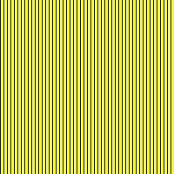
color Blue = color(0, 0, 255);
color Yellow = color(255, 255, 0);
void setup() {
size(200, 200);
background(Yellow);
loadPixels();
for (int i = 0; i < width*height; i+= 4) {
pixels[i] = Blue;
}
}
void draw() {
}
void mousePressed() {
updatePixels();
}
1
2
4
5
6
0
7
1
2
3
200, 201, etc
in next row
3
First we load the pixels[] array with loadPixels(). The values of each pixel on screen are loaded into their corresponding position in the array.
Then we manipulate those values in some way. for (int i = 0; etc
To see the results we update the screen pixels with updatePixels().
BlueOnYellowPixels0

Slide 9
color Blue = color(0, 0, 255);
color Yellow = color(255, 255, 0);
void setup() {
size(200, 200);
background(Yellow);
loadPixels();
for (int i = 0; i < width*height; i+= 4) {
pixels[i] = Blue;
}
updatePixels();
save("P1.jpg");
}
There is no delay for a mousePressed() event here
BlueOnYellowPixels1

Slide 10



void setup() {
size(W, H);
N = W * H;
background(Yellow);
loadPixels();
frameRate(1000);
}
int i = 0;
void draw() {
if(i < N) {
pixels[i] = Blue;
i+= 4;
updatePixels();
}
}
Much slower because updates are done at the frame rate, here about 600-700 despite request for 1000!
BlueOnYellowPixels2

Slide 11

color Blue = color(0, 0, 255);
color Yellow = color(255, 255, 0);
void setup() {
size(200, 200);
background(Yellow);
loadPixels();
}
void draw() {
for (int i = 0; i < height; i+= 4) {
for (int j = 0; j < width; j++) {
pixels[i * width + j] = Blue;
}
}
}
void mousePressed() {
updatePixels();
}
Why do we need two for statements here?
BlueOnYellowPixels3

Slide 12
color Blue = color(0, 0, 255);
color Yellow = color(255, 255, 0);
void setup() {
size(200, 200);
background(Yellow);
loadPixels();
}
void draw() {
for (int i = 0; i < height; i+= 4) {
for (int j = 0; j < width; j++) {
pixels[i * width + j] = Blue;
}
}
updatePixels();
}
BlueOnYellowPixels4

Slide 13




color Blue = color(0, 0, 255);
color Yellow = color(255, 255, 0);
void setup() {
size(200, 200);
background(Yellow);
loadPixels();
frameRate(1000);
}
int i = 0,
j = 0;
void draw() {
if(i < width) {
if(j < height) {
pixels[i * width + j] = Blue;
updatePixels();
j++;
}
else {
if(i < width) {
j = 0;
i+= 4;
}
}
}
}
BlueOnYellowPixels5

Slide 14

PImage Pic;
Pic = loadImage("Small Mona Lisa.jpg");
size(Pic.width, Pic.height);
image(Pic, 0, 0);
No tricks this time! Well not yet!
MonaLisa3

Slide 15
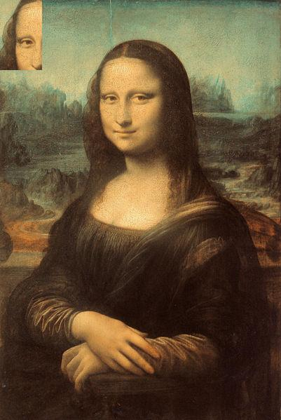
PImage Pic;
Pic = loadImage("Small Mona Lisa.jpg");
size(Pic.width, Pic.height);
image(Pic, 0, 0);
PImage Part = get(120, 80, 60, 100);
image(Part, 0, 0);
60
100
80
get(x, y, w, h) gets the set of pixels in the rectangle whose upper left corner is at (x, y) with width w and height h and returns them as a PImage object. This can then be displayed using image().
120
MonaLisa4

Slide 16
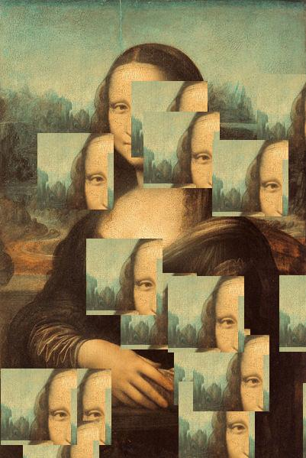
PImage Pic;
Pic = loadImage("Small Mona Lisa.jpg");
size(Pic.width, Pic.height);
image(Pic, 0, 0);
int N = 16;
int i;
PImage Part = get(80, 80, 100, 100);
for(i = 0; i < N; i++) {
image(Part, random(width), random(height));
}
MonaLisa5

Slide 17
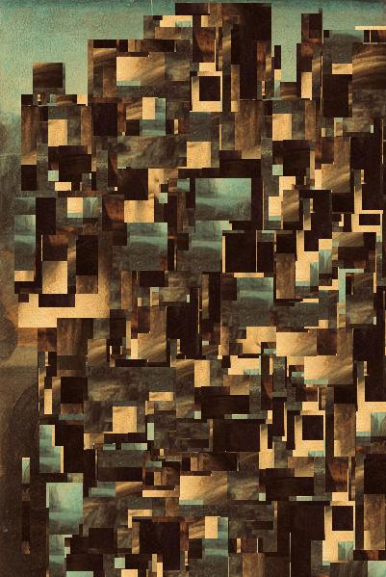
PImage Pic;
Pic = loadImage("Small Mona Lisa.jpg");
size(Pic.width, Pic.height);
image(Pic, 0, 0);
int N = 100;
int i;
PImage Part;
for(i = 0; i < N; i++) {
Part = get(80 + int(random(320)),
80 + int(random(400)), 100, 100);
image(Part, random(width), random(height));
}
MonaLisa6

Slide 18
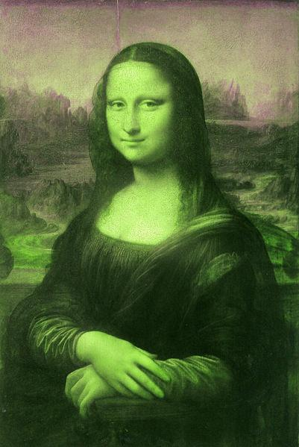
PImage Pic;
void setup() {
Pic = loadImage("Small Mona Lisa.jpg");
size(Pic.width, Pic.height);
println(width + " " + height);
set(0, 0, Pic);
}
void draw() {
}
void mousePressed() {
float Red,
Green,
Blue;
loadPixels();
background(0);
for (int i = 0; i < width*height; i++) {
Red = red(pixels[i]);
Green = green(pixels[i]);
Blue = blue(pixels[i]);
pixels[i] = color(Green, Red, Blue);
}
updatePixels();
}
MonaLisa7

Slide 19

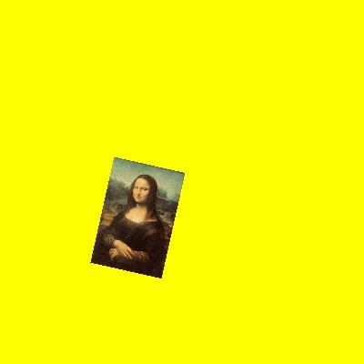
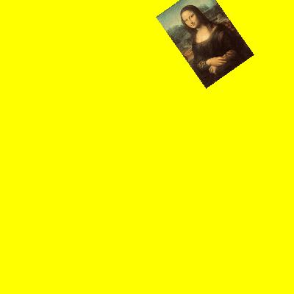
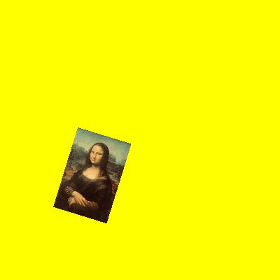
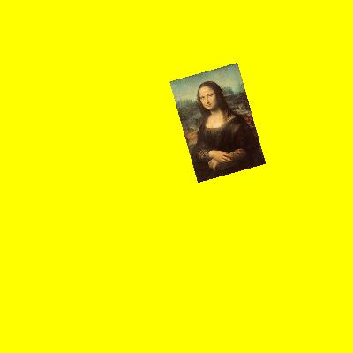
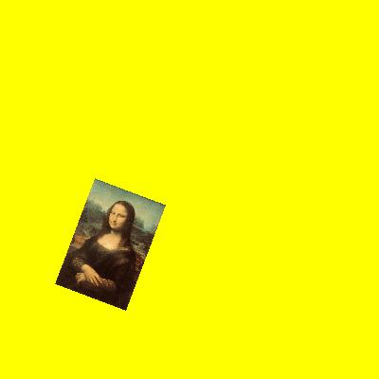
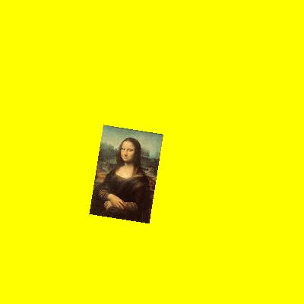
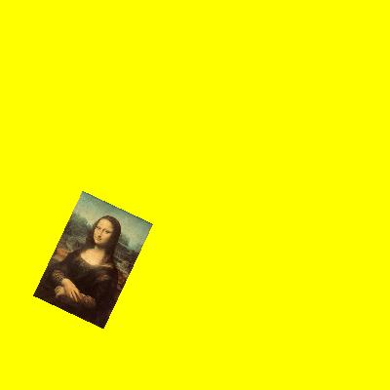
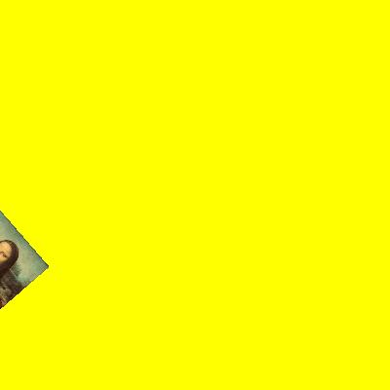
PImage Pic;
float Red,
Green,
Blue;
int W = 400,
H = W;
int PW,
PH;
int Div = 5;
float Theta = 0;
float dTheta = 0.01;
color Yellow = color(255, 255, 0);
void setup() {
size(W, H, P3D);
Pic = loadImage("Small Mona Lisa.jpg");
PW = Pic.width/Div;
PH = Pic.height/Div;
}
void draw() {
background(Yellow);
rotateZ(Theta);
image(Pic, W/2 - PW/2, H/2 - PH/2, PW, PH);
Theta += dTheta;
}
_3DImage1

Slide 20
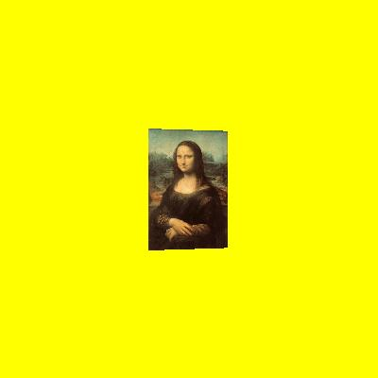
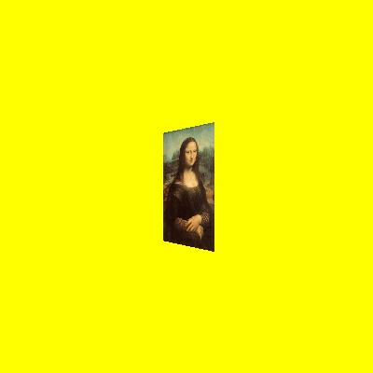
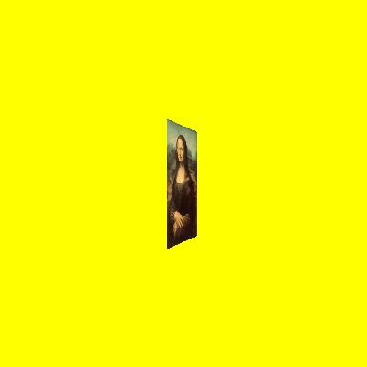
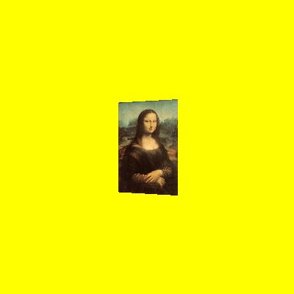
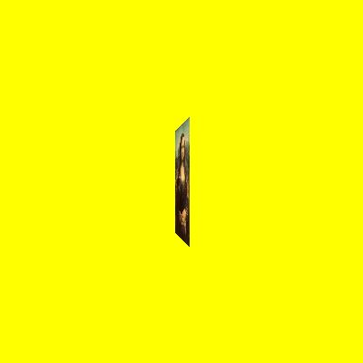
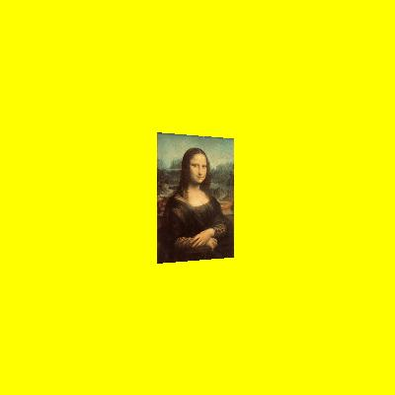
PImage Pic;
int W = 400,
H = W;
int PW,
PH;
int Div = 5;
float Theta = 0;
float dTheta = 0.01;
color Yellow = color(255, 255, 0);
void setup() {
size(W, H, P3D);
Pic = loadImage("Small Mona Lisa.jpg");
PW = Pic.width/Div;
PH = Pic.height/Div;
translate(W/2, H/2);
}
void draw() {
background(Yellow);
translate(W/2, H/2 - PH/2, 20);
rotateY(Theta);
image(Pic, -PW/2, 0, PW, PH);
Theta += dTheta;
}
_3DImage2

Slide 21
int W = 400,
H = W;
Square S;
int Cx = 0,
Cy = 0;
int HalfSide = 40;
float Rx = 0.0,
Ry = 0.0,
Rz = 0.0;
PFont Font;
void setup() {
size(W, H, P3D);
Font = loadFont("Calibri-Bold-20.vlw");
textFont(Font);
S = new Square(Cx, Cy, HalfSide);
}
void draw() {
background(White);
translate(W/2, H/2, 0);
rotateX(Rx);
rotateY(Ry);
rotateZ(Rz);
S.Col = Green;
S.LCol = Black;
S.Legend = "1";
translate(0, 0, HalfSide);
S.Draw();
S.Col = Red;
S.LCol = Black;
S.Legend = "2";
rotateX(PI/2);
translate(0, HalfSide, HalfSide);
S.Draw();
S.Col = Blue;
S.LCol = Black;
S.Legend = "3";
rotateX(PI/2);
translate(0,-HalfSide, -HalfSide);
S.Draw();
S.Col = Orange;
S.LCol = Black;
S.Legend = "4";
rotateX(PI/2);
translate(0,HalfSide, HalfSide);
S.Draw();
S.Col = C1;
S.LCol = Black;
S.Legend = "5";
rotateY(PI/2);
translate(HalfSide, 0, HalfSide);
S.Draw();
S.Col = Yellow;
S.LCol = Black;
S.Legend = "5";
translate(0, 0, - 2 * HalfSide);
S.Draw();
}
PictureCube1

Slide 22
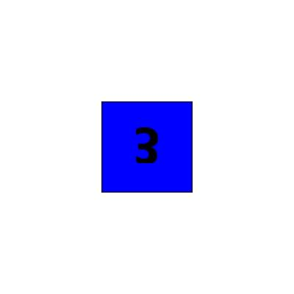
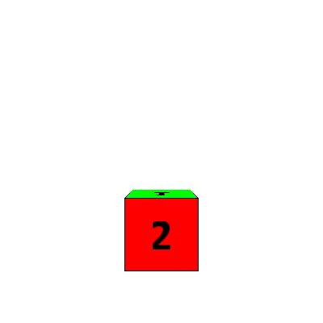
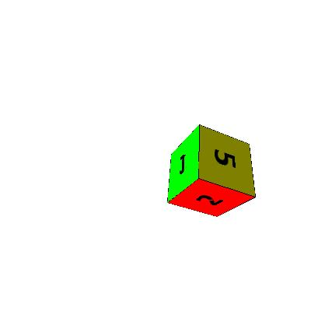
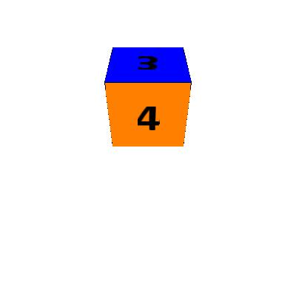
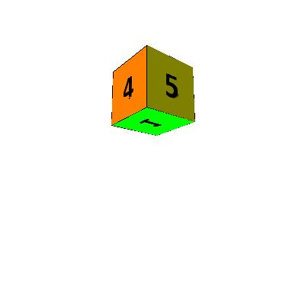
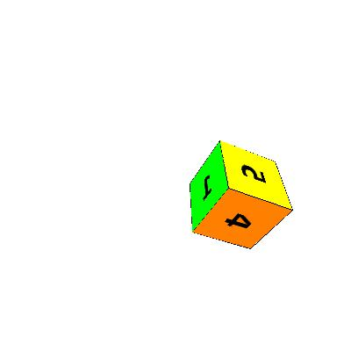
void keyPressed() {
switch(key) {
case 'x':
Rx += 0.1;
break;
case 'y':
Ry += 0.1;
break;
case 'z':
Rz += 0.1;
break;
case 'u':
Rx -= 0.1;
break;
case 'v':
Ry -= 0.1;
break;
case 'w':
Rz -= 0.1;
break;
case 'a':
Rx = 0;
break;
case 'b':
Ry = 0;
break;
case 'c':
Rz = 0;
break;
}
}
PictureCube1

Slide 23
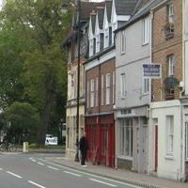
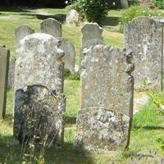
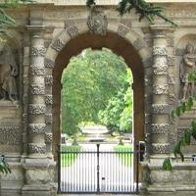
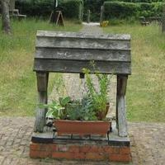
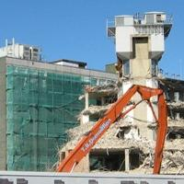

class Cube {
float Side;
float[] Rots;
PImage[] Pics;
Cube(PImage[] Pics) {
this.Pics = Pics;
Side = Pics[0].width;
}
void Draw() {
pushMatrix();
translate(0, 0, Side/2);
image(Pics[0], -Side/2, -Side/2);
popMatrix();
pushMatrix();
rotateX(PI/2);
translate(-Side/2, -Side/2, Side/2);
image(Pics[1], 0, 0);
popMatrix();
pushMatrix();
rotateX(PI);
translate(-Side/2, -Side/2, Side/2);
image(Pics[2], 0,0);
popMatrix();
pushMatrix();
rotateX(3 * PI/2);
translate(-Side/2, -Side/2, Side/2);
image(Pics[3], 0,0);
popMatrix();
pushMatrix();
rotateY(PI/2);
translate(-Side/2, -Side/2, Side/2);
image(Pics[4], 0,0);
popMatrix();
pushMatrix();
rotateY(3 * PI/2);
translate(-Side/2, -Side/2, Side/2);
image(Pics[5], 0,0);
popMatrix();
}
}
PictureCube2
Cube

Slide 24
int W = 800,
H = W;
Cube PC;
float Rx = 0.0,
Ry = 0.0,
Rz = 0.0;
float dRx = 0.0,
dRy = 0.0,
dRz = 0.0;
PImage[] Pics = new PImage[6];
void setup() {
size(W, H, P3D);
Pics[0] = loadImage("P1.jpg");
Pics[1] = loadImage("P2.jpg");
Pics[2] = loadImage("P3.jpg");
Pics[3] = loadImage("P4.jpg");
Pics[4] = loadImage("P5.jpg");
Pics[5] = loadImage("P6.jpg");
PC = new Cube(Pics);
}
void draw() {
background(White);
pushMatrix();
translate(W/2, H/2, 0);
rotateX(Rx);
rotateY(Ry);
rotateZ(Rz);
PC.Draw();
popMatrix();
Rx += dRx;
Ry += dRy;
Rz += dRz;
}
PictureCube2

Slide 25
void keyPressed() {
switch(key) {
case 'x':
Rx += 0.1;
break;
case 'y':
Ry += 0.1;
break;
case 'z':
Rz += 0.1;
break;
case 'u':
Rx -= 0.1;
break;
case 'v':
Ry -= 0.1;
break;
case 'w':
Rz -= 0.1;
break;
case 'a':
Rx = 0;
break;
case 'b':
Ry = 0;
break;
case 'c':
Rz = 0;
break;
case 'i':
dRx += 0.01;
break;
case 'j':
dRy += 0.01;
break;
case 'k':
dRz += 0.01;
break;
case 'l':
dRx -= 0.01;
break;
case 'm':
dRy -= 0.01;
break;
case 'n':
dRz -= 0.01;
break;
case 'p':
dRx = 0;
break;
case 'q':
dRy = 0;
break;
case 'r':
dRz = 0;
break;
}
}
PictureCube2

Slide 26













PictureCube2

Slide 27
class ImageChopper {
String Name;
String Ext;
PImage Pic;
int Width,
Height;
int SideH,
SideV;
int W,
H;
int Cx,
Cy;
ImageChopper(String IP1, String IP2, String IP3, String IP4) {
this.Name = IP1;
this.Ext = IP2;
this.Width = int(IP3);
this.Height = int(IP4);
Pic = loadImage(Name + '.' + Ext);
size(Pic.width, Pic.height);
Cx = width/2;
Cy = height/2;
}
void Draw() {
image(Pic, 0, 0);
stroke(Yellow);
noFill();
rectMode(CENTER);
rect(Cx, Cy, Width, Height);
}
ImageChopper

Slide 28
void MousePressed() {
size(Width, Height);
image(Pic, -Cx + Width/2, -Cy + Height/2);
save("Pi.jpg");
}
void KeyPressed() {
switch(key) {
case 'l':
Cx--;
break;
case 'r':
Cx++;
break;
case 'u':
Cy--;
break;
case 'd':
Cy++;
break;
}
}
}
ImageChopper

Slide 29





Slide 30

ImageChopper IC;
String Name;
String Ext;
void setup() {
frame.setResizable(true);
String[] IP = loadStrings("Input.txt");
IC = new ImageChopper(IP[0], IP[1], IP[2], IP[3]);
}
void draw() {
IC.Draw();
}
void mousePressed() {
IC.MousePressed();
}
void keyPressed() {
IC.KeyPressed();
}
Pic6
jpg
200
200
ImageChopperDevelopment
ImageChopper
Note how the draw(), mousePressed() and keyPressed() methods are delegated to IC, the ImageChopper object.
ImageChopperDevelopment

